Slide 1
QA – Rapid Testing Examples
September 2009

Slide 2
What are the Benefits?
Rapid Testing helps testers to learn the application/functionality prior to commencing any formal testing.
Reading the requirements or specifications (if they exist) rarely gives you a good sense of how a piece of functionality actually behaves.
  The user documentation may not capture the “look and feel” of a piece of functionality. This is essential when testing a product dependent on a good user experience
Defects found while conducting ‘Rapid Testing’ are often examples of entire classes of forgotten test cases or requirements/specification
Functional test cases derived from requirements stop yielding defects after few builds or test cycles. Using the ‘Ad Hoc’ method, the tester can test functionality relying on skill and intuition, accompanied by their experience and exposure to other similar/previous test candidates.

Slide 3
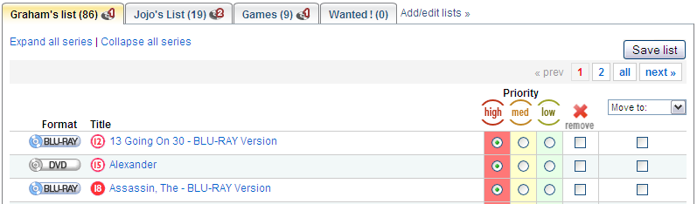
Example
In the previous slide we mentioned that “you can test functionality relying on skill and intuition”
  ‘Rapid Testing’ is unplanned but there still needs to be some theoretical planning behind the approach. Lets look at an example:
Below we have a snippet from the rental list. A typical test could be...
  Set ‘Alexander’ to a ‘medium’ priority?
    By clicking the ‘medium’ bullet option on the row of ‘Alexander’ this would start the process, but What if I clicked ‘Save List’ or ‘Remove’ against another title whilst the action was still being performed? Is it possible the user can do this? If so, what happens?
This approach may then open up a raft of questions to the design.
  Should the list be disabled to prevent interaction whilst an operation is in progress?
  Should the list simply handle the request / operation simultaneously?
These are all fundamental questions that if not asked during the design phase, will likely produce a bug or error.

Slide 4
Rapid Testing Upfront
  So... You have finished your code that ‘allows a user to modify a rental list priority’ and its ready to go into QA.
What can you do to help ensure that no bugs are found during the testing phase?
Start by...
  Thinking about how the user may interact with the options they have in front of them (how they might prioritise their rental list). Put yourself in the mindset of a paying customer who expects ‘Everything!’ to work perfectly.
  There are many different types of users, some of which are fast at interacting with on-screen objects; so look at:
    Potential impact on refresh issues
    Simultaneous conflict (objects interacted at the same time sharing the same code or variables)
    Multiple clicking the same on-screen objects (There are a lot of impatient users out there)
IMPORTANT ! Do not assume that a customer or user will know the work around to a problem you are aware of. It’s still a bug ! Even if it is “Browser specific”

Slide 5

Is there really that much to test using the Rapid Testing approach?
The simple answer is YES !
  There is a reason why Microsoft relies on BETA testing by the general public. The permutations are huge. Lets just look at a tiny aspect of the rental list page and identify some permutations.
A single tab on the rental list
Possible test items include:
  Can the title accommodate unusual characters such as ‘hyphens’ or ‘apostrophes’ (These can cause issues with SQL queries)?
  Does the number on the tab represent the correct number of movie rentals that reside beneath it?
  Is the number representing the quantity of disc allocations to this list correct?
  What happens when a user clicks on the name within the tab versus the tab itself?
  What happens when a user clicks and drags the tab on screen, potentially by accident?
  Is the user able to copy and paste the text of the tab to the windows clipboard? If so, should this be permitted?

Slide 6
Rapid Testing – Getting Started
Where to Begin...
  Before starting on your ‘Rapid Testing’ journey you need to forget about how the piece or area of functionality (that you may have been working on) has been developed.
  Ask yourself “As a user, what is my ‘end goal’. What do I want to achieve when I venture down the applicable area of functionality. Lets use another example...
Change of a customer address on LOVEFiLM
  In this Rapid Testing scenario, the user has moved home and simply has 3 objectives in mind:
    Log-in to the site
    Change home address in the fastest way and be confident it has been achieved
    Potentially check their rental list before logging out

Slide 7
Example: Change of Address: Step 1
Log-in
  On this user journey the user will need to log-in to the site. From a Rapid Testing perspective you may want to think about the following steps:
    Navigate to the LOVEFiLM log-in page
    Enter Log-In information that is incorrect
    Click ‘Forgot username/password’ and check email reminder works
    Re-Enter a valid Log-in username and password
Finding where to change address
  Click the ‘My Account’ link at the top of the page (Typically the user will use this as it is right at the top of the page and would be anticipated as the fastest way for the user to change their details)
  Alternatively you can also try clicking the ‘Help’ link and conducting a dynamic search using text such as “How can I change my postal address?”

Slide 8
Example: Change of Address: Step 2
Changing Address
  On the ‘My Account’ page there appears to be 2 different ways on how a user can change their address
    Clicking ‘My Delivery Details’ on the left navigation bar
    Clicking ‘Change’ next to ‘Shipping Address’ on the centre screen
  Both of these methods could be tested in such a way where even an additional test can be performed which would validate whether a user is able to change their delivery address twice in succession. Remember that Rapid Testing can open examples of entire classes of forgotten test cases or requirements/specification.
Postcode Lookup
  The user now has the ability to use our postcode lookup feature. Therefore lets first see what happens when a single character is entered. What should the user see?
  Try entering a valid postcode into the lookup field and click ‘Find Address’ without refreshing the screen first
  Check to make sure the ‘Change’ button works after using a valid postcode
  And finally, make sure that the valid address is found and the user can apply this

Slide 9
Example: Change of Address: Step 3
Logging Out via the Rental List
  Confirming the address change on the ‘My Account’ screen the user is happy, however what are the chances of the user just logging out straight away?
    Maybe they want to now change their payment method too
    Maybe they want to view their rental list
    Start an account holiday or change email address
All of the above are simply a small number of possible permutations for the remainder of the users journey
IMPORTANT:
  Typically users are consistently driven by what is most prominent when they have no immediate objective (i.e. changing their address details). Things that will drive your Rapid Testing tests will likely be:
    Images
    Bold Text
    Central Text or Eye Catching Text Content

Slide 10
The 2 Key Areas to ALWAYS consider
Functional
Navigational
User manually forcing refreshes on a page
Navigating through direct URLs (Copy/Pasting) and URL manipulation
Multiple Browsers
Multiple tabs active on the same LOVEFiLM account
Case sensitivity (Is CAPS lock left turned on, on the user machine)
Users may want to return to a single start point (e.g. Clicking on the ‘Home’ tab after each screen navigation)
Users can click multiple times on links which have not had time to refresh
Clicking a new link prior to a page completing its loading
Mouse over functionality and hovering text

Slide 11
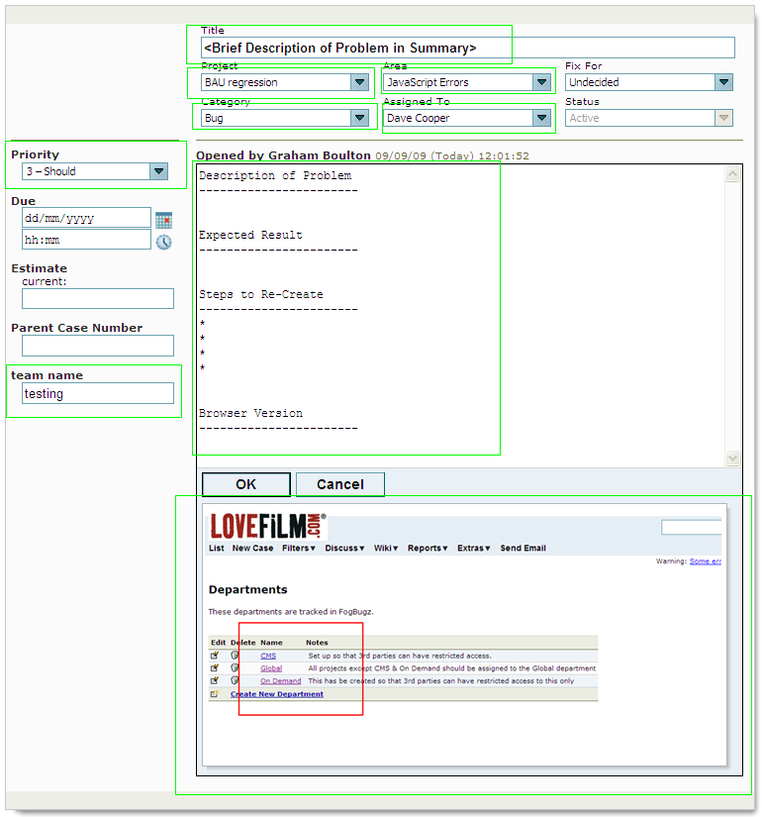
Raising a Bug in
Fogbugz
Clear Title (Summary of the Problem)
Assign correct project
Select appropriate area
Category = Bug
Assign to the applicable individual
Set priority to an appropriate level
  Critical = Nothing works !
  Must = Major Functional problem with no workaround.
  Should = Functional problem with a workaround.
  Could = Ideally should be fixed but unlikely to cause contact.
Bug Content MUST include the following detail:
  Description of the Problem
  Expected Result
  Clear ‘Steps to Reproduce’ the problem
  Browser version (if specific to bug)
  Screenshot

